Slide 1

FINAL YEAR PROJECT REPORT
INTERNATIONAL STUDENT ADMISSION ANALYSIS FOR HIGHER EDUCATION
PREPARED BY:AHMED ABDI MOHAMED
(B032020059)
PREPARED FOR: Ts. DR. ZURAIDA BT ABAL ABAS

Slide 2

TABLE OF
CONTENTS
1.Introduction.................................................. 3 2.Objectives.........................................................4 3.Problem Statement...........................................5 4.Methodology......................................................6 5.Analysis and Results........................................7 6.Demo......................................................................8 7.Conclusion..............................................................9

Slide 3
Introduction
Dashboard for Analysing International Student Admissions
Good morning . Thank you for joining us today.
Today, I would like to share about the International Student Admission Analysis Dashboard, a project that aims to transform data-driven decision-making in international student admissions.
"Making informed decisions about international student admissions is more important than ever in today's rapidly changing educational landscape. Data-driven approaches provide the insights required to effectively navigate these challenges.

Slide 4
Problem Statement
The modern admissions process generates massive amounts of data. Applications, transcripts, test scores, demographic information, and more.
Managing this data and extracting relevant insights from it is a daunting task that frequently results in fragmented and disconnected data silos.
Both domestic and international students' expectations are changing, necessitating personalized experiences and quick, tailored responses.
We introduce the International Student Admission Analysis Dashboard to address these challenges.

Slide 5
Objectives of the project
Our project has three key goals:
1.Create a user-friendly data analytics dashboard for international higher
education institutions.
2. Recognise major enrollment trends and patterns in admission data.
3.Use predictive analytics to forecast future student enrollments for better
resource planning.

Slide 6
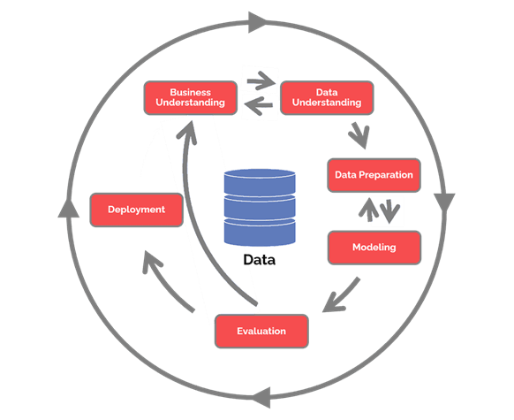
Project Methodology
Our methodology adheres to the CRISP-DM (Cross- Industry Standard Process for Data Mining) model, which provides a structured framework for data mining initiatives.
These phases include Business Understanding, Data Understanding, Data Preparation, Modelling, Evaluation, and Deployment.
We gathered admission data from multiple sources while maintaining data integrity and consistency.
CRISP-DM Diagram

Slide 7
Results and Analysis
Data-driven decision-making is critical in education and international student admissions, says the content.
This section provides a thorough examination of the results generated by our International Student Admission Analysis Dashboard for the top five countries: Egypt, Somalia, Sudan, Yemen, and the United Arab Emirates.
We trained our models using data from 2016 to 2020 and tested them from 2021 to 2023, extending our predictions to 2024, 2025, and 2026.
We used the Mean Absolute Percentage Error (MAPE) as a critical performance metric to evaluate model performance

Slide 8
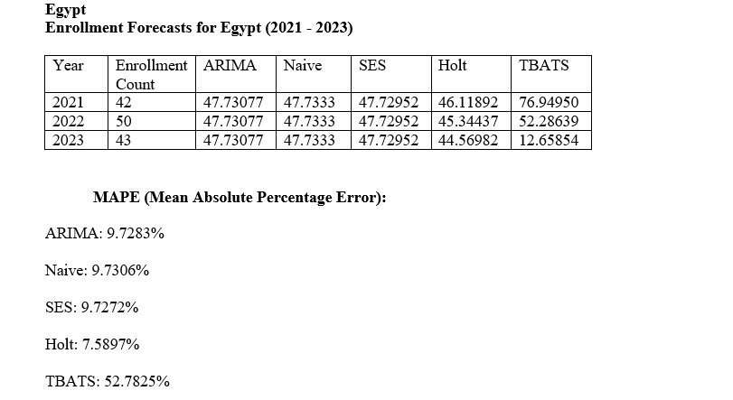

Slide 9
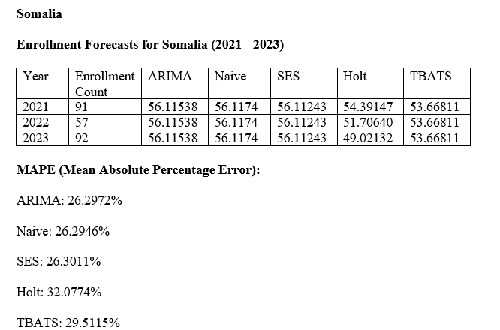

Slide 10
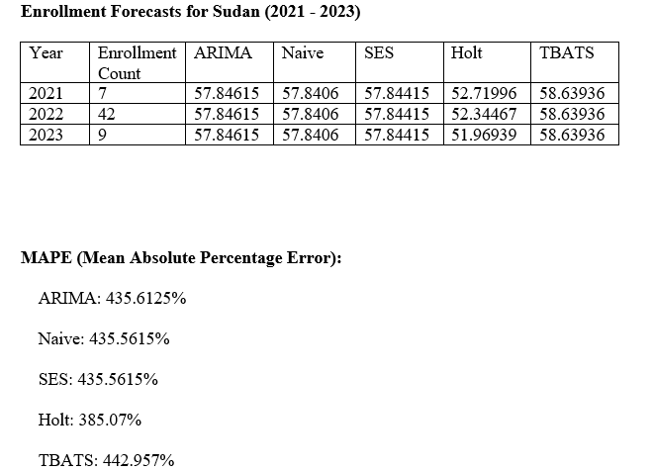

Slide 11
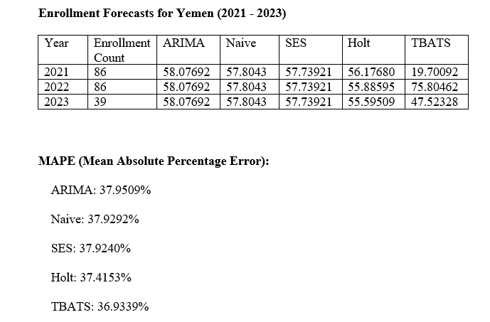

Slide 12
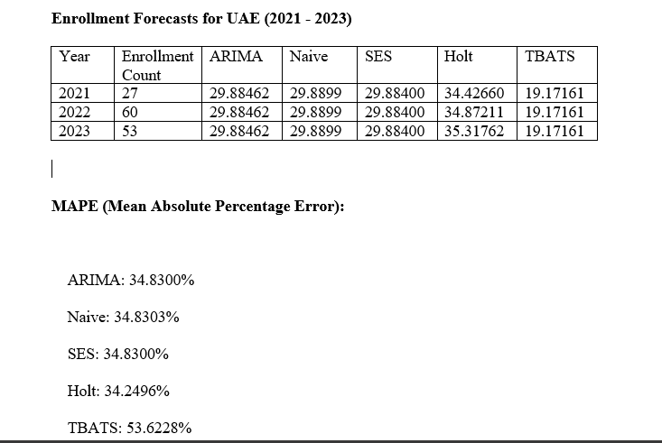

Slide 13
Dashboard Demo
Let's take a closer look at the International Student Admission Analysis Dashboard in action.
"We'll look at how it provides insights into enrollment trends, assists institutions in making data-driven decisions, and contributes to better resource planning.

Slide 14
Conclusion
In conclusion, the International Student Admission Analysis Dashboard provides data-driven insights to educational institutions and policymakers. Our methodology, powered by predictive analytics, ensures informed decisions in a rapidly evolving landscape.
As we move forward, the dashboard will continue to improve international student admissions strategies, ultimately benefiting both students and institutions.

Slide 15


